Slide 1
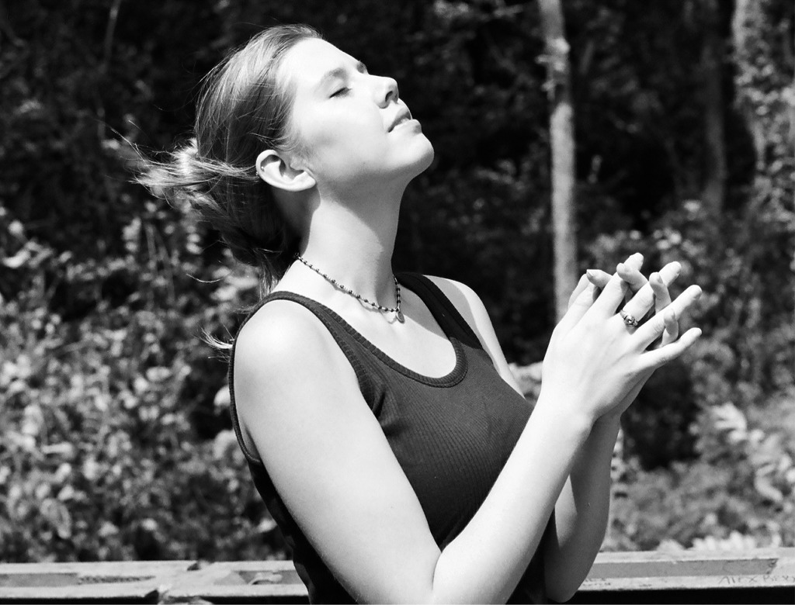
A vision which leads to worship
Revelation 1:9-20

Slide 2
A vision which leads to worship
What is “worship”?

Slide 3
A vision which leads to worship
What is “worship”?
What is good worship?

Slide 4
A vision which leads to worship
Revelation
Good Worship Instruction Manual

Slide 5
A vision which leads to worship
1. The circumstances: 1:9-11
I, John, your brother and companion in the suffering and kingdom and patient endurance that are ours in Jesus, was on the island of Patmos because of the word of God and the testimony of Jesus. On the Lord’s Day I was in the Spirit, and I heard behind me a loud voice like a trumpet, which said: “Write on a scroll what you see and send it to the seven churches: to Ephesus, Smyrna, Pergamum, Thyatira, Sardis, Philadelphia and Laodicea.”

Slide 6
A vision which leads to worship
1. The circumstances: 1:9-11
Tribulation

Slide 7
A vision which leads to worship
1. The circumstances: 1:9-11
Tribulation
The kingdom

Slide 8
A vision which leads to worship
1. The circumstances: 1:9-11
Tribulation
The kingdom
Perseverance

Slide 9
A vision which leads to worship
The circumstances
The vision – John “in the Spirit”

Slide 10
A vision which leads to worship
The circumstances
The vision – John “in the Spirit”
4 visions:
  1:10 - the message to the churches
  4:2 – the central visions
  17:3 – in the desert
  21:10 – in the mountain

Slide 11
A vision which leads to worship
The circumstances
The vision – John “in the Spirit”
Description of the one who speaks
I turned around to see the voice that was speaking to me. And when I turned I saw seven golden lampstands, and among the lampstands was someone like a son of man, dressed in a robe reaching down to his feet and with a golden sash around his chest. The hair on his head was white like wool, as white as snow, and his eyes were like blazing fire. His feet were like bronze glowing in a furnace, and his voice was like the sound of rushing waters. In his right hand he held seven stars, and coming out of his mouth was a sharp, double-edged sword. His face was like the sun shining in all its brilliance.

Slide 12
A vision which leads to worship
The circumstances
The vision – John “in the Spirit”
Description of the one who speaks
Seven golden lampstands

Slide 13
A vision which leads to worship
The circumstances
The vision – John “in the Spirit”
Description of the one who speaks
Seven golden lampstands
A “son of man” (Daniel 7)

Slide 14
A vision which leads to worship
The circumstances
The vision – John “in the Spirit”
Description of the one who speaks
Seven golden lampstands
A “son of man” (Daniel 7)
His appearance (Daniel 10)

Slide 15
A vision which leads to worship
The circumstances
The vision – John “in the Spirit”
Description of the one who speaks
Seven golden lampstands
A “son of man” (Daniel 7)
His appearance (Daniel 10)
The long robe + sash = High Priest
Hair, eyes, feet and voice

Slide 16
A vision which leads to worship
The circumstances
The vision – John “in the Spirit”
Description of the one who speaks
Seven golden lampstands
A “son of man” (Daniel 7)
His appearance (Daniel 10)
The long robe + sash = High Priest
Hair, eyes, feet and voice
Two-edged sword from his mouth

Slide 17
A vision which leads to worship
The circumstances
The vision – John “in the Spirit”
Description of the one who speaks
Seven golden lampstands
A “son of man” (Daniel 7)
His appearance (Daniel 10)
“He made my mouth like a sharpened sword” Isaiah 49:2
The long robe + sash = High Priest
Hair, eyes, feet and voice
Two-edged sword from his mouth

Slide 18
A vision which leads to worship
The circumstances
The vision – John “in the Spirit”
Description of the one who speaks
Seven golden lampstands
A “son of man” (Daniel 7)
His appearance (Daniel 10)
“The word of the Lord is sharper than any two-edged sword, it penetrates…it judges…” Heb 4:12
The long robe + sash = High Priest
Hair, eyes, feet and voice
Two-edged sword from his mouth

Slide 19
A vision which leads to worship
The circumstances
The vision – John “in the Spirit”
Description of the one who speaks
John’s reaction (1:17a)
“I fell at his feet as though dead”
Compare:
Moses – Exodus 3:6
Isaiah – (6:5)
Ezekiel – (1:28; 3:22-23; 43:1-3)

Slide 20
A vision which leads to worship
The circumstances
The vision – John “in the Spirit”
Description of the one who speaks
John’s reaction (1:17a) - worship
Two words describe worship:
pay homage

Slide 21
A vision which leads to worship
The circumstances
The vision – John “in the Spirit”
Description of the one who speaks
John’s reaction (1:17a) - worship
Two words describe worship:
pay homage + fear and fascination

Slide 22
A vision which leads to worship
The circumstances
The vision – John “in the Spirit”
Description of the one who speaks
John’s reaction (1:17a) - worship
Two words describe worship:
pay homage + fear/fascination
service (work)

Slide 23
A vision which leads to worship
The circumstances
The vision – John “in the Spirit”
Description of the one who speaks
John’s reaction – adoration
True service (1:17b-20)
Then he placed his right hand on me and said: “Do not be afraid. I am the First and the Last. I am the Living One; I was dead, and now look, I am alive for ever and ever! And I hold the keys of death and Hades. Write, therefore, what you have seen, what is now and what will take place later. The mystery of the seven stars that you saw in my right hand and of the seven golden lampstands is this: The seven stars are the angels of the seven churches, and the seven lampstands are the seven churches”.

Slide 24
A vision which leads to worship
The circumstances
The vision – John “in the Spirit”
Description of the one who speaks
John’s reaction – adoration
True service (1:17b-20)
“Don’t be afraid”

Slide 25
A vision which leads to worship
The circumstances
The vision – John “in the Spirit”
Description of the one who speaks
John’s reaction – adoration
True service (1:17b-20)
“Don’t be afraid”
“ I am the first and the last, the living one; I was dead, and behold I am alive!”

Slide 26
A vision which leads to worship
The circumstances
The vision – John “in the Spirit”
Description of the one who speaks
John’s reaction – adoration
True service (1:17b-20)
“Don’t be afraid”
“ I am the first and the last, the living one; I was dead, and behold I am alive!”
Your mission – “write therefore…”

Slide 27
A vision which leads to worship
The circumstances
The vision – John “in the Spirit”
Description of the one who speaks
John’s reaction – adoration
True service (1:17b-20)
The identity of the lampstands

Slide 28
A vision which leads to worship
The circumstances
The vision – John “in the Spirit”
Description of the one who speaks
John’s reaction – adoration
True service (1:17b-20)
The identity of the lampstands
Conclusions:
What is good worship?

Slide 29
A vision which leads to worship
The circumstances
The vision – John “in the Spirit”
Description of the one who speaks
John’s reaction – adoration
True service (1:17b-20)
The identity of the lampstands
Conclusions:
What is good worship?
Is Christ really our Lord?

Slide 30
A vision which leads to worship
The circumstances
The vision – John “in the Spirit”
Description of the one who speaks
John’s reaction – adoration
True service (1:17b-20)
The identity of the lampstands
Conclusions:
What is good worship?
Is Christ really our Lord?
How good is our service?

